Slide 1
Breaking the Softmax Bottleneck
Reporter: Lu Shuai
2019.8.7

Slide 2
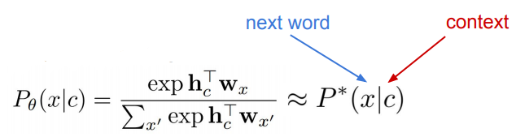

Softmax
Natural language as conditional distributions
Parametric distributions & softmax:
Challenge: Can we always find 𝛳 s.t. for all c:
No, when embedding size < label cardinality (vocab size) !

Slide 3
Breaking the Softmax Bottleneck:
A High-Rank RNN Language Model
Zhilin Yang, Zihang Dai, Ruslan Salakhutdinov, William W. Cohen
ICLR 2018

Slide 4

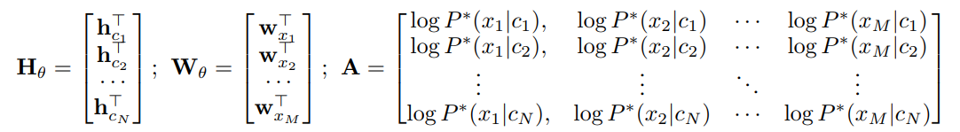
Softmax Bottleneck
H: context vectors W: word embeddings
A: log probabilities of the true data distribution

Slide 5

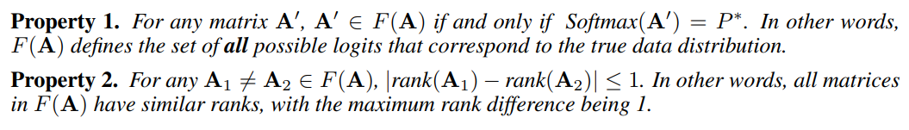
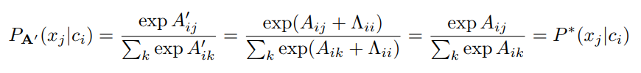







Softmax Bottleneck
Proof of Property 1:
$$→$$
$$←$$
$$⟹$$
$$⟹$$
Notes:
相当于在A的每行都加上任意数字

Slide 6


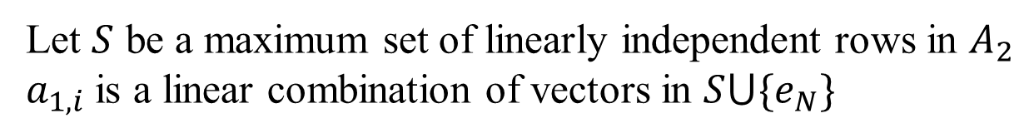
Softmax Bottleneck
Proof of Property 2:
Let $S$ be a maximum set of linearly independent rows in $A_{2}$
$a_{1,i}$ is a linear combination of vectors in $S⋃\{e_{N}\}$

Slide 7
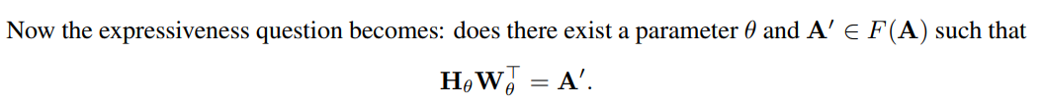
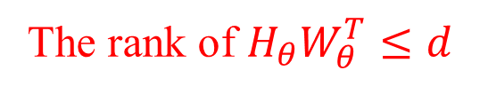
Softmax Bottleneck
The rank of $H_{θ}W_{θ}^{T}≤d$
Notes:
矩阵分解问题

Slide 8
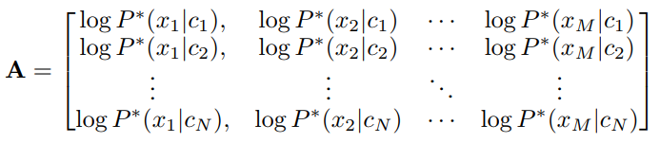
Why A is High Rank?
It is difficult prove it since we do not have access to the true data distribution of a natural language.
If A is low-rank, it means humans only need a limited number (e.g. a few hundred) of bases, and all semantic meanings can be created by (potentially) negating and (weighted) averaging these bases.
Empirically, the rank of A can possibly be as high as M
Notes:
矩阵分解问题

Slide 9
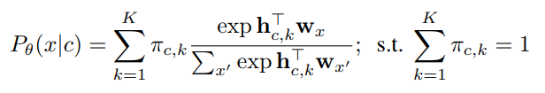

Mixture of Softmax (MoS)
Computes K Softmax distributions and uses a weighted average of them as the next-token probability distribution.
Notes:
矩阵分解问题

Slide 10
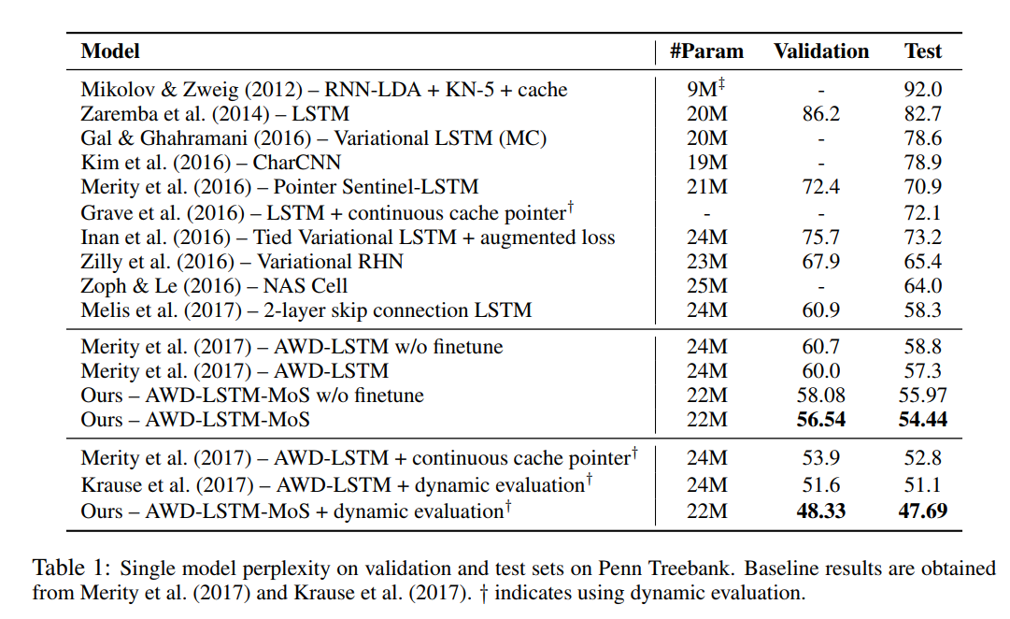
Results
Notes:
矩阵分解问题

Slide 11
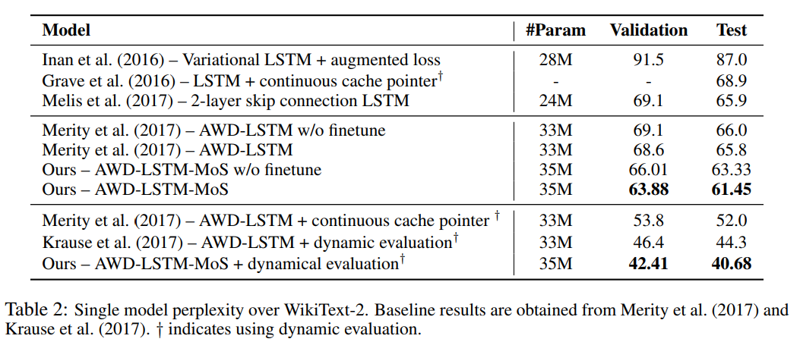
Results
Notes:
矩阵分解问题

Slide 12
Sigsoftmax: Reanalysis of the Softmax Bottleneck
Sekitoshi Kanai, Yasuhiro Fujiwara, Yuki Yamanaka, Shuichi Adachi
NeurIPS 2018

Slide 13
Reanalysis of the softmax bottleneck
Log-softmax
*The log-softmax has at most d + 1 linearly independent output vectors, even if the various inputs are applied to the model.
Notes:
没有指出 最直接的原因

Slide 14
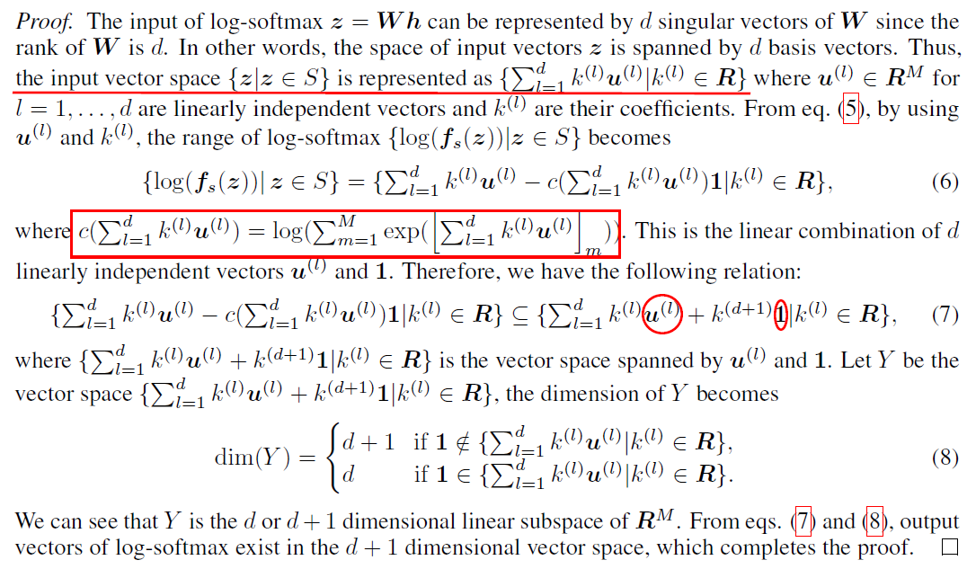
Reanalysis of the softmax bottleneck
Proof of Theorem 2:

Slide 15
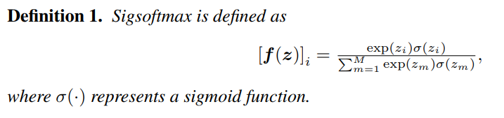

Sigsoftmax
Log-softmax

Slide 16
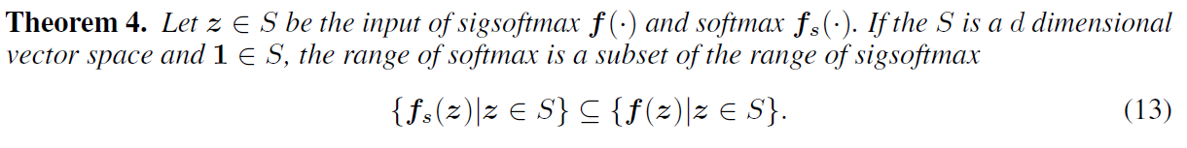

Sigsoftmax
Even if the vectors of the true log probabilities are more than d + 1 linearly independent vectors, the sigsoftmax-based model can learn the true probabilities.
If $1∉S$, the range of sigsoftmax can include the range of softmax by introducing one learnable scalar parameter b into sigsoftmax as
Notes:
反证法，举了个反例

Slide 17
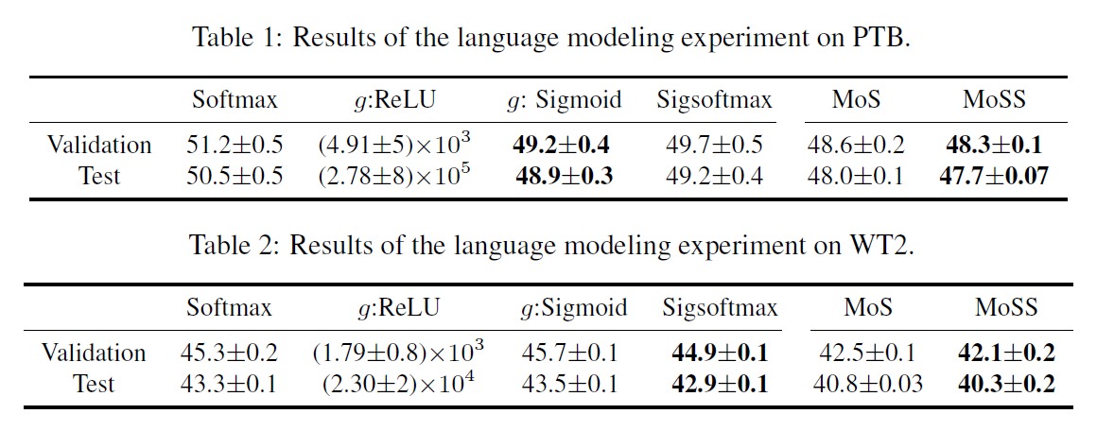
Results
Notes:
反证法，举了个反例

Slide 18
Breaking the Softmax Bottleneck
via Learnable Monotonic Pointwise Non-linearities
Octavian Ganea, Sylvain Gelly, Gary Bécigneul, Aliaksei Severyn
ICML 2019

Slide 19


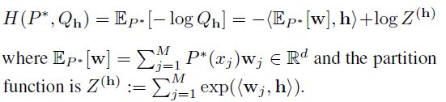
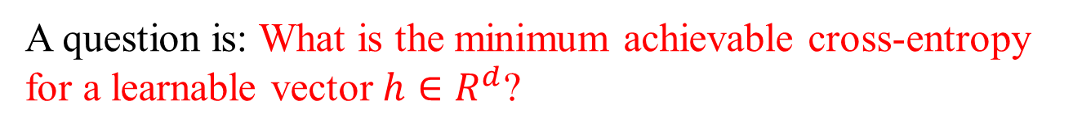
Quantifying the Error
How "bad" this bottleneck can be, which depends on the choice of the distance function between discrete probability distributions.
Cross Entropy
A question is: What is the minimum achievable cross-entropy for a learnable vector $h∈R^{d}$?

Slide 20
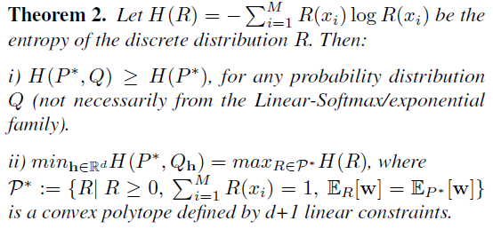
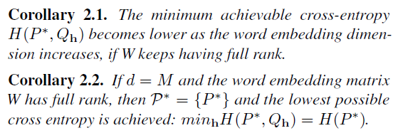
Quantifying the Error
Increasing the word embedding dimension and assuming the word embedding matrix W has full rank (i.e. the new constraints cannot be derived from the previous constraints) implies that the polytope P* "shrinks", i.e. the maximum entropy becomes lower.
Notes:
KL散度非负性 大于等于很容易，小于等于用最大熵定理

Slide 21

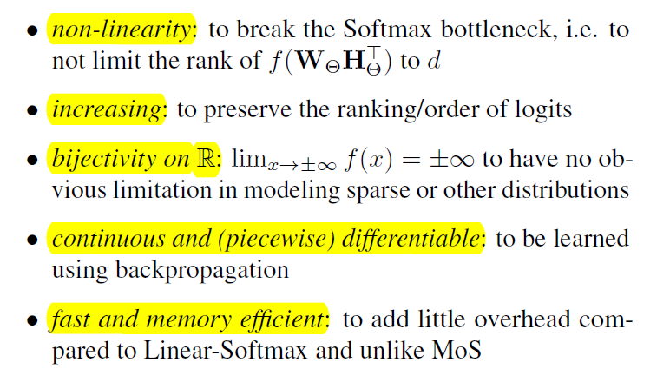
Monotonic Pointwise Functions
Notes:
非线性、单调增、双射、连续可微

Slide 22
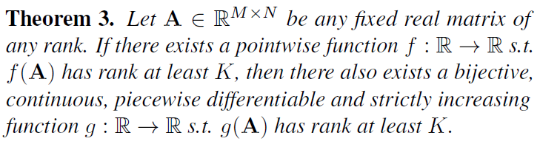
Theoretical Results
How powerful are monotonic pointwise non-linearities?
We prove that the conditions imposed above on pointwise f’s are not restrictive when concerned about matrix rank increase.
Notes:
数学分析

Slide 23
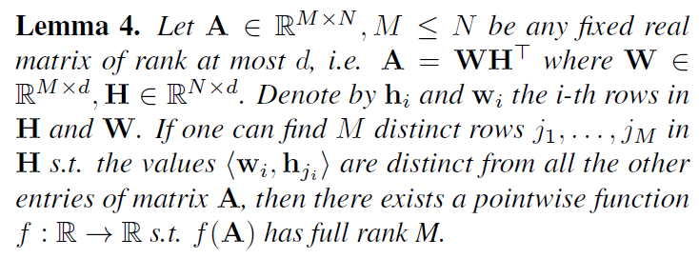
Theoretical Results
Making a matrix full-rank via pointwise operators.
In the most useful case, we would like to know when such operators can make it full rank.

Slide 24
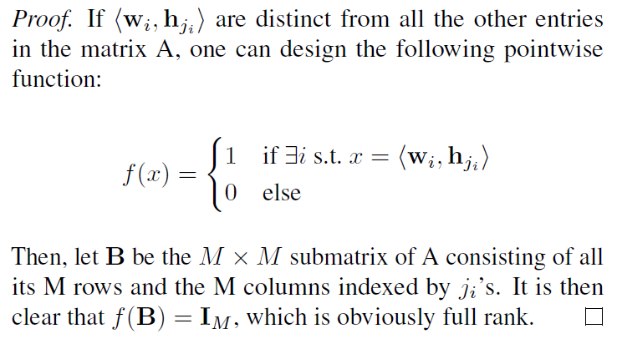
Theoretical Results
Making a matrix full-rank via pointwise operators.
Proof of Lemma 4:

Slide 25
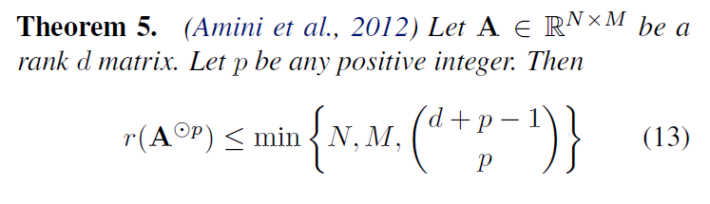
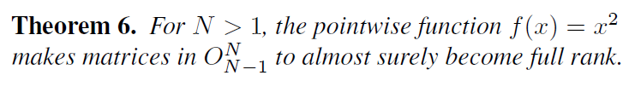
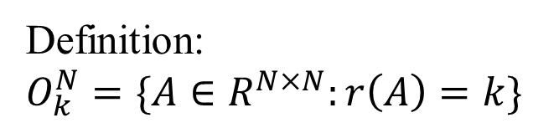

Theoretical Results
Making a matrix full-rank via pointwise operators.
$$f\left(x\right)=x^{p}$$
Definition:
$$O_{k}^{N}=\{A∈R^{N×N}:r\left(A\right)=k\}$$
Notes:
2个引理，证了两页

Slide 26
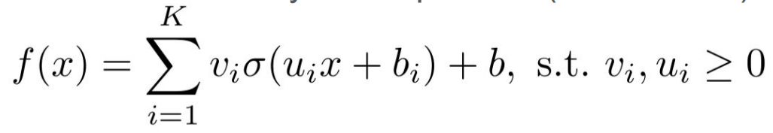
Theoretical Results
Architecture(s) of Learnable Monotonic Functions
Even though some particular pointwise functions can make a low-rank matrix to be full-rank, it is not guaranteed that this new matrix is close to the true data matrix.
Learnable parametric monotonic real functions
An one hidden layer neural network with K hidden units and positively constraint weights

Slide 27
Theoretical Results
Architecture(s) of Learnable Monotonic Functions
This class of functions are proved to be universal approximator for all continuous increasing functions. (When K is large enough!)
How to address the computation problem?
PLIF = Piecewise Linear Increasing Functions.

Slide 28
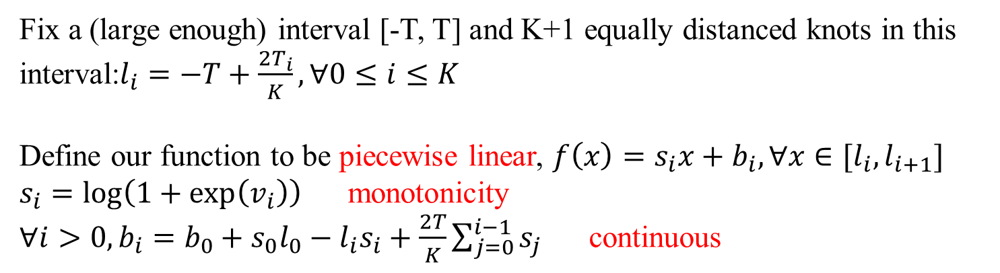
Theoretical Results
Architecture(s) of Learnable Monotonic Functions
PLIF = Piecewise Linear Increasing Functions.
Fix a (large enough) interval [-T, T] and K+1 equally distanced knots in this interval:$l_{i}=−T+\frac{2T_{i}}{K},∀0≤i≤K$
Define our function to be piecewise linear, $f\left(x\right)=s_{i}x+b_{i},∀x∈[l_{i},l_{i+1}]$
$s_{i}=\log\left(1+\exp\left(v_{i}\right)\right)$ monotonicity
$∀i>0,b_{i}=b_{0}+s_{0}l_{0}−l_{i}s_{i}+\frac{2T}{K}\sum_{j=0}^{i−1}{s_{j}}$ continuous

Slide 29
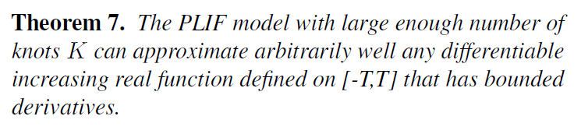
Theoretical Results
Architecture(s) of Learnable Monotonic Functions
PLIF = Piecewise Linear Increasing Functions.

Slide 30

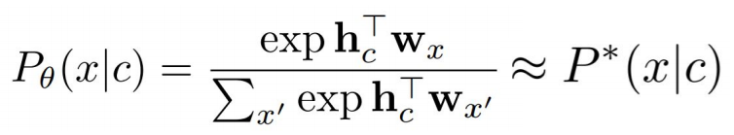
Results
Synthetic Experiment
Goal: separate softmax bottleneck from context embedding bottleneck
Sample N different categorical distributions with M outcomes:
Learn

Slide 31
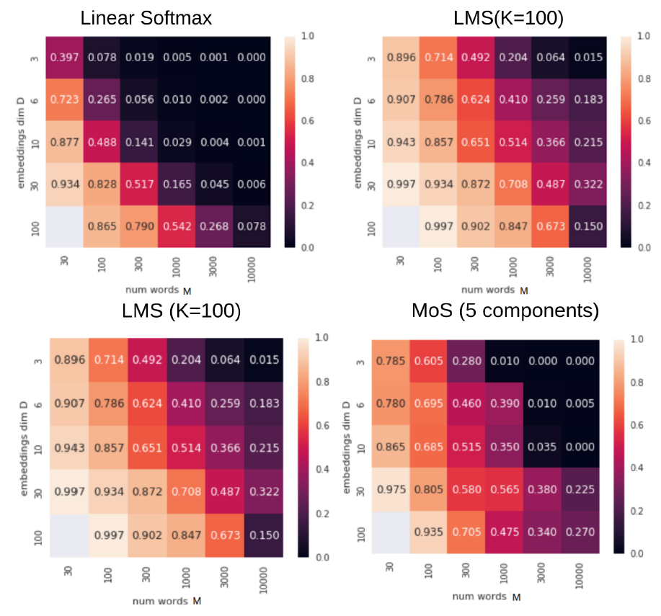

Results
Synthetic Experiment
Percentage of contexts c for which

Slide 32
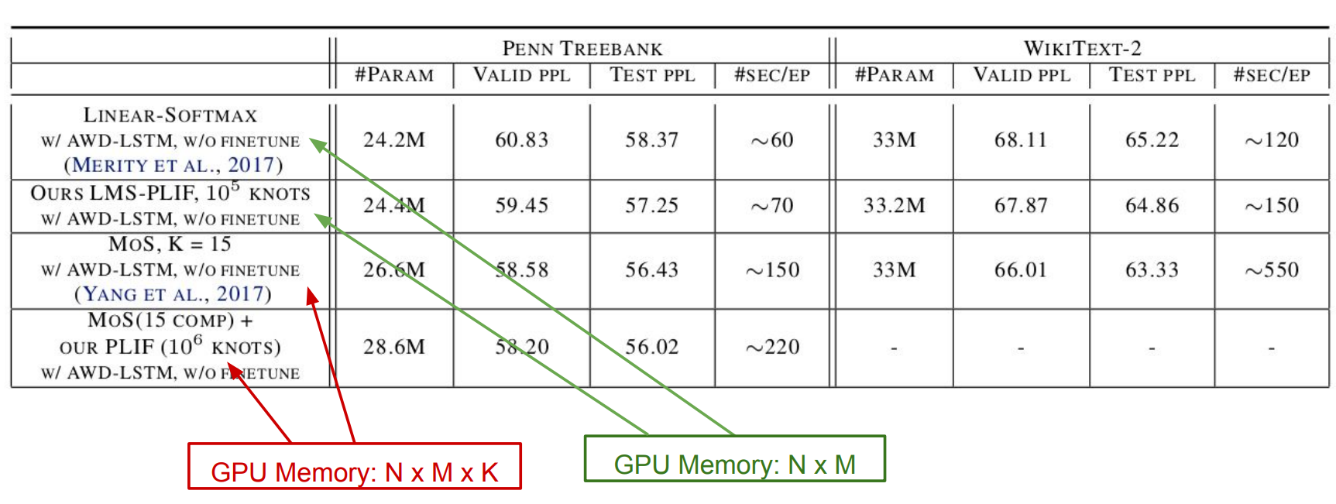
Results
Language Model Experiments

